Slide 1

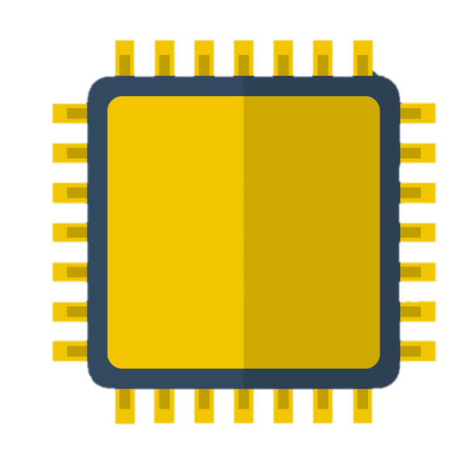
ALGORITHMS IN HARDWARE
The Project
The goal of this project is to present one such algorithm, a systolic modular exponentiation system, in VHDL on our FPGA board.
Method
In order to reach the projects goal, we familiarized ourselves with the hardware programming language VHDL, its function on the FPGA board, and Montgomery’s Residue (M-res) for modular arithmetic. Modular exponentiation uses M-res to allow hardware to work in parallel and optimize speed.
Abstract
The application of cryptographic algorithms in hardware is utilized for security and performance reasons in various public-key cryptosystems. The overall aim of the project is to implement algorithms in hardware. The design of the algorithm and logic circuit for a systolic system for modular exponentiation has been defined by Kornerup in A Systolic, Linear-Array Multiplier for a Class of Right-Shift Algorithms [1]. In order to design this algorithm in VHDL, some other functions were first developed.
Conclusion
We encountered a wide degree of problems throughout our project. This included both software and hardware problems, some of which we were able to overcome. Despite our best efforts at fixing a copying mechanism on the modular exponentiator, and after numerous hours and a great deal of testing, the systolic system for modular exponentiation was not a working construction.
Systolic Multiplier Cell
The systolic multiplier cell can be connected in a series to multiply larger numbers. The numbers are taken in binary and is also output in binary through a shift register.
Full Adder
The full adder takes 3 inputs and gives 2 outputs
Group 65b
Simon Karing • Mathias Helsengren • Mads Riis Rasmussen • Kim Hoang Le

